Slide 1

Game ‘N Watch
Andrew Storrow
Ben Roux
John Reese

Slide 2
Project Overview
Lists existing and upcoming video games
Supports all major gaming platforms
Tracks games of interest to users
Allows friends list behaviours
Detailed reports by genre, platform, or developer
Gathers sales and financial statistics

Slide 3
Planned Technologies
Presentation Tier
  JSP / JSF
Application Tier
  Java
  Spring Framework
Database Tier
  mySQL

Slide 4
Spring Framework
Spring MVC web pages hosted by Apache Tomcat
Spring RMI backend services
Integrated JDBC communication with DBMS

Slide 5
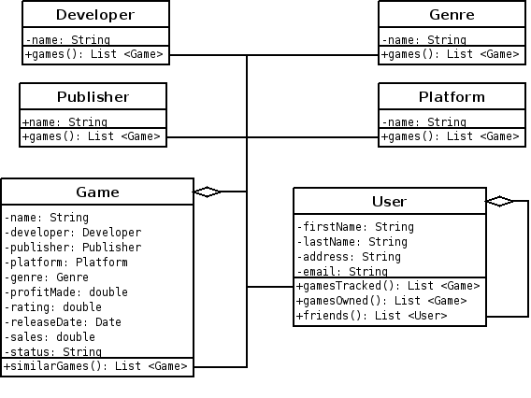
Application Tier

Slide 6
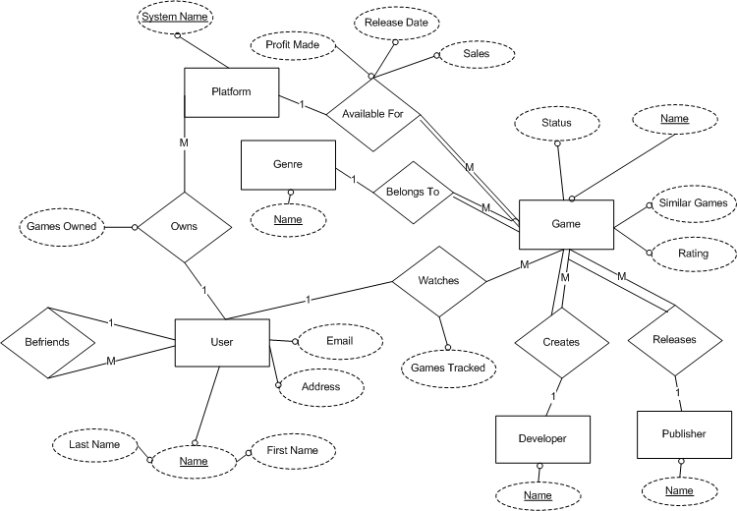
Database Tier

Slide 7
Identified Risks
Unfamiliar Technologies
Spring Framework
Initial Project Scope

Slide 8
Reflection
Secured technologies and hardware
Learning Spring MVC
Resisting over-engineering

Slide 9
What’s Next
Establishing MVC architecture using Spring
Choosing between RMI and SOAP
Implement functionality

Slide 10
Prototype Demo

Slide 11
Questions?

